Slide 1

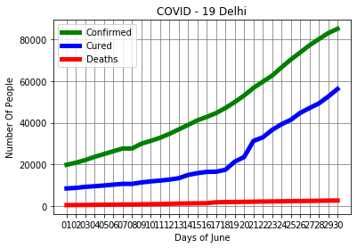
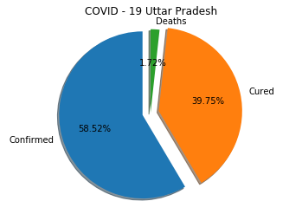
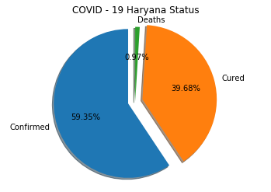

COVID 19 Status of Delhi with Neighbouring States in June,2020
As lockdown period will be over by 30th June and unlock period will begin. As the confirmed cases are 59.11% which is slighest above UP cases. Cured status of Delhi with other two states is on similar pattern. But in death rate Delhi is in front row.To begin unlockdown 2nd phase its necessary for Delhi Govt to startwith Preventive Measures for the safety of its people.
-Allow the unlokdown in odd-even pattern of time.
-Regular monitoring of outgoing and incoming population in the Delhi area.
-24/7 hotline help for people should be available.
-Allowing opening of shops and other public areas with specific guidelines.
- Awareness about Covid prevention should be on large scale.
-Large empty spaces shoulf be used as quarantine centres.
Status of Data in June

